Slide 1
DIGITAL BOARD MARKER(Storage Efficient System for Class Lectures) (Final Year Project)
Advisor:
Mr. Samyan Qayyum Wahla
Group Members:
Muhammad Haris Khan [2016-CS-105]
Hamza Farooq [2016-CS-122]
Ayesha Atif [2016-CS-152]
Komal Shehzadi [2016-CS-178]

Slide 2
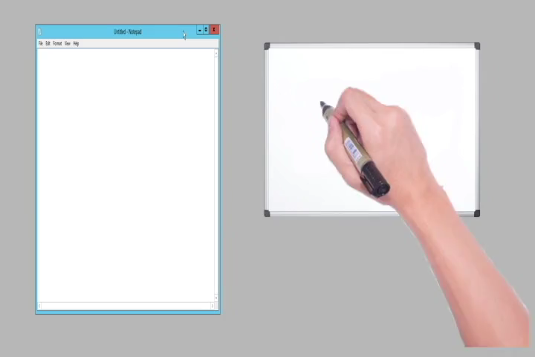
Demo Video

Slide 3
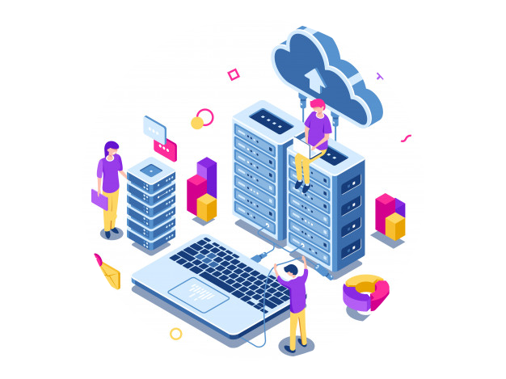

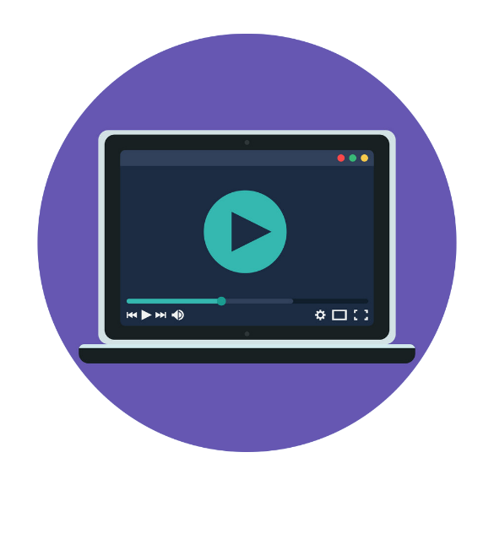

PROJECT OVERVIEW
Storage Efficient System
Complete LMS
Bandwidth Efficient System
Offline Player

Slide 4

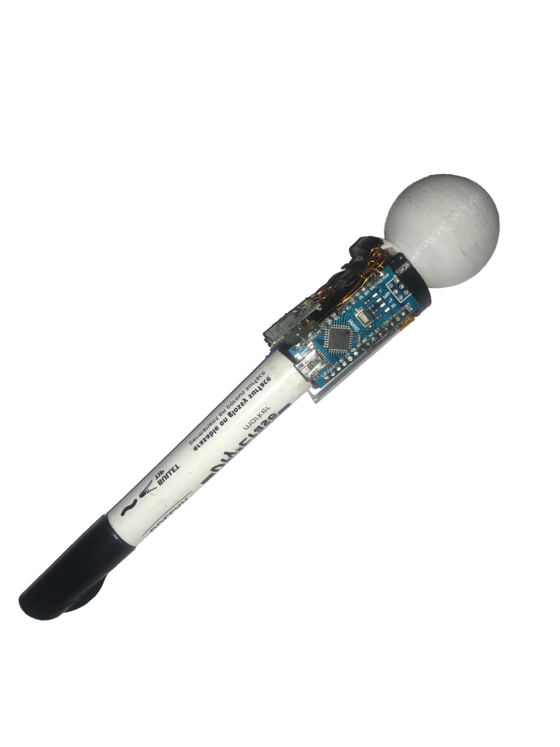


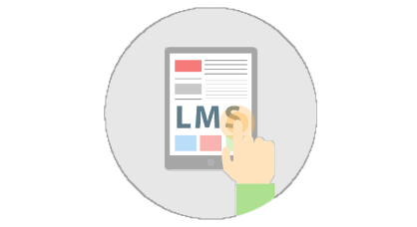

MOTIVATION
Minimizing Resources.
Difficulty in writing the notes as well as listening and understanding.
Less bandwidth usage.
Less storage.
Play lectures without internet and more storage.

Slide 5
PROBLEM STATEMENT
“To make a storage and bandwidth efficient system with a lecture player and learning management system for the students and the educational institutes.”

Slide 6


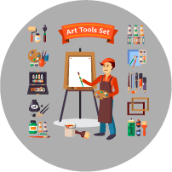

APPLICATION AREAS
Educational Institutes
DBM
Applications
Industrial Presentations
Sketch Artists
Online Tutors

Slide 7
COMPARISON WITH EXISTING SYSTEMS
Initiative | Storage Space per sec | Storage Efficiency | Encrypted format | Dedicated Player | Custom Content | Brandable | Free to Access | For Profit | Class Strength
Edx | 793.6 KB | ✕ | ✕ | ✕ | ✓ | ✓ | ✓ | ✕ | 300,000
Moodle | 720 KB | ✕ | ✕ | ✕ | ✕ | ✓ | ✓ | ✓ | 10,000
Coursera | 750 KB | ✕ | ✕ | ✕ | ✓ | ✕ | ✓ | ✓ | Unlimited
Udemy | 790 KB | ✕ | ✕ | ✕ | ✓ | ✕ | ✕ | ✓ | Unlimited
Udacity | 790 KB | ✕ | ✕ | ✕ | ✓ | ✓ | ✓ | ✓ | Unlimited
DBM | 14.5 KB | ✓ | ✓ | ✓ | ✓ | ✓ | ✓ | ✓ | Unlimited

Slide 8
Requirements/Success Scenarios
Controller Application
Teacher starts controller application.
Lecture starts recording.
Lecture ends and file stored in local pc.
Lecture file uploaded on server.
Lecture can be downloaded in offline player and can be played.

Slide 9
Requirements/Success Scenarios
Website
Users register to the website.
Users login to website.
Users add/view/delete course depending upon designation.
Users add/view/delete course content depending upon designation.
Course content includes assignments, announcements, lecture notes.
Users can play lectures that was recorded by teacher using controller application.

Slide 10
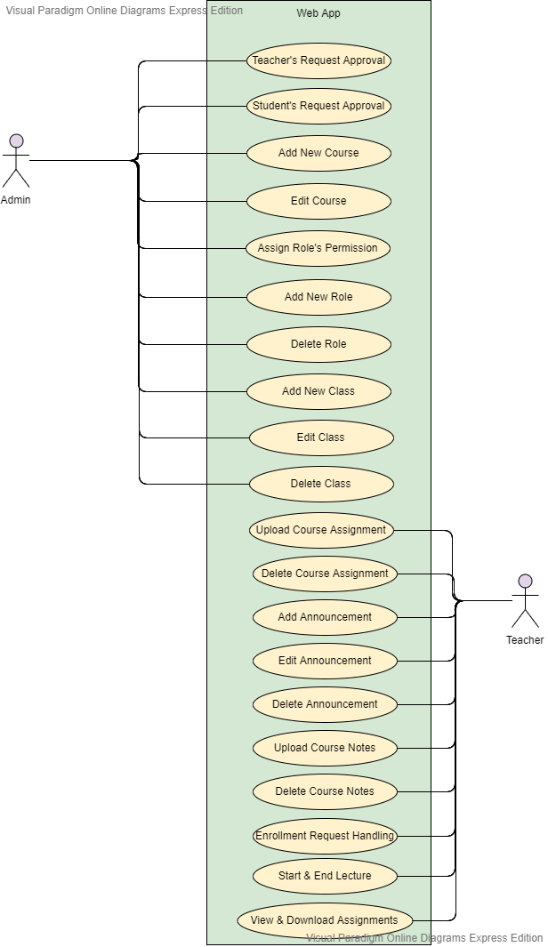
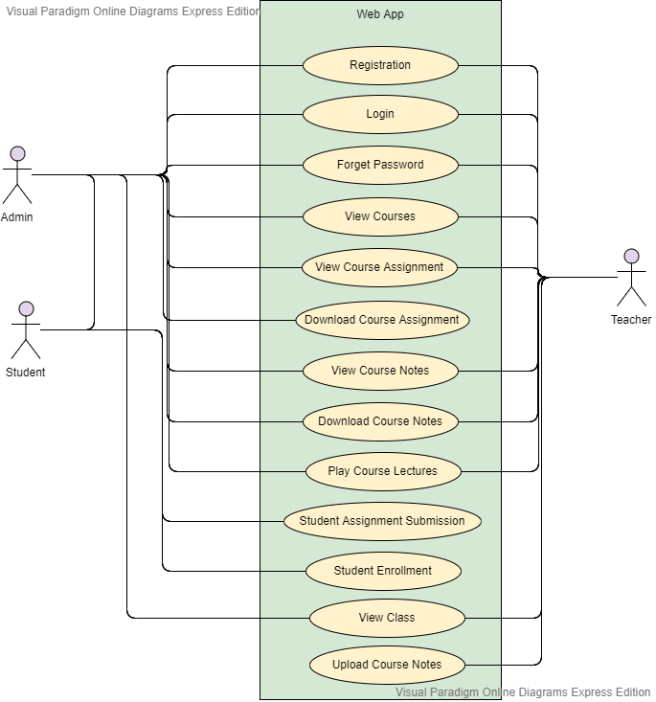
Web APP Use Cases:

Slide 11
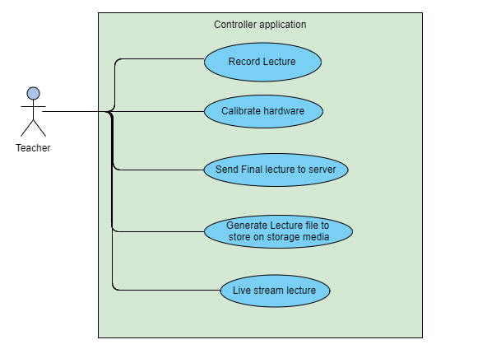
Controller App Use Case

Slide 12
Project Milestones
Modules | Duration | Completion
Marker Hardware | 1 Month | ✓
Controller Application | 2 Months | ✓
Online Player Application | 2 Months | ✓
Voice Transceiver | 1 Month | ✓
WebGL Player | 1 Month | ✕
LMS | 4 Months | ✕

Slide 13
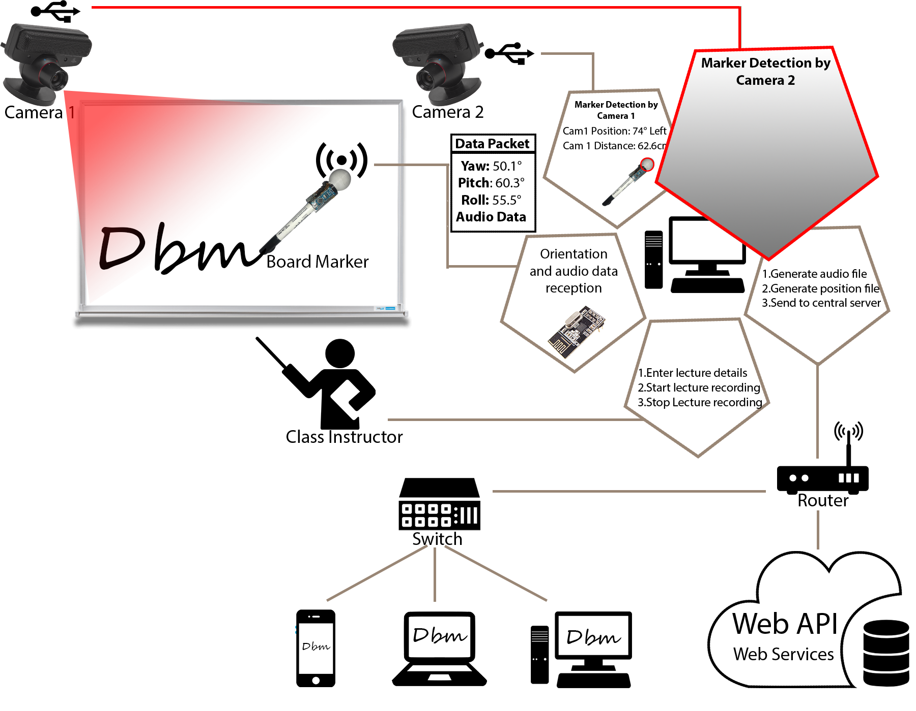
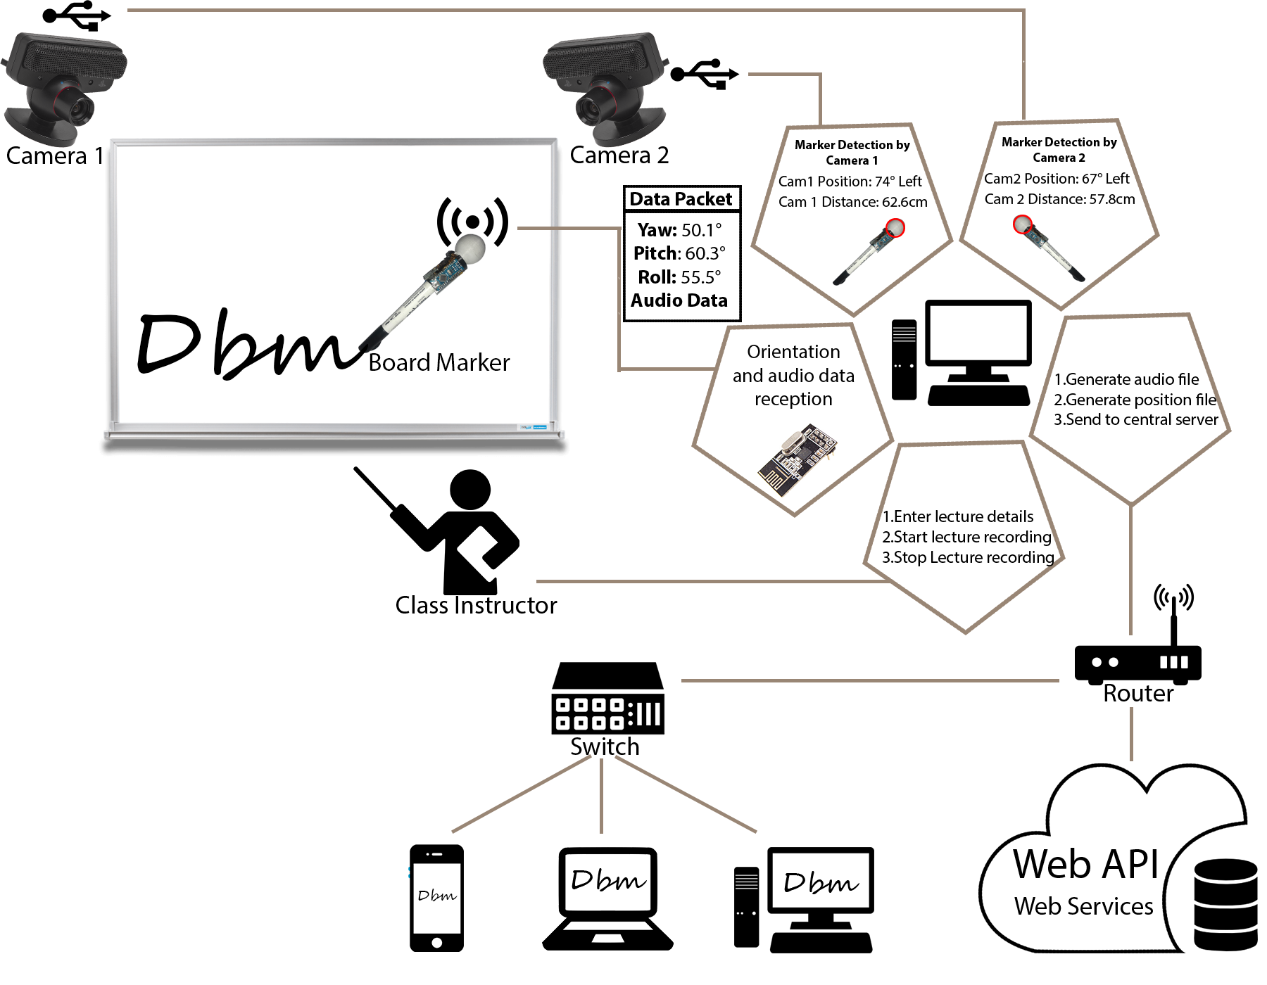
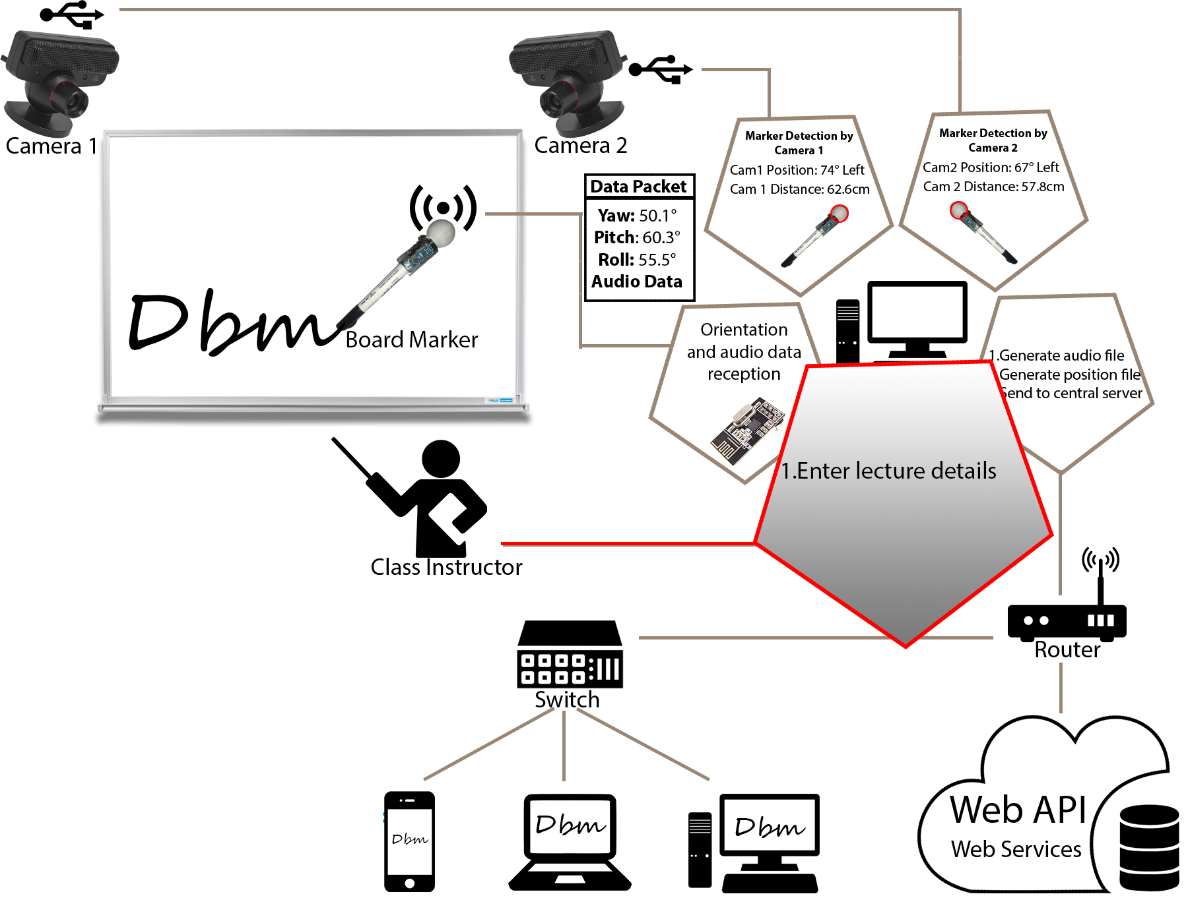
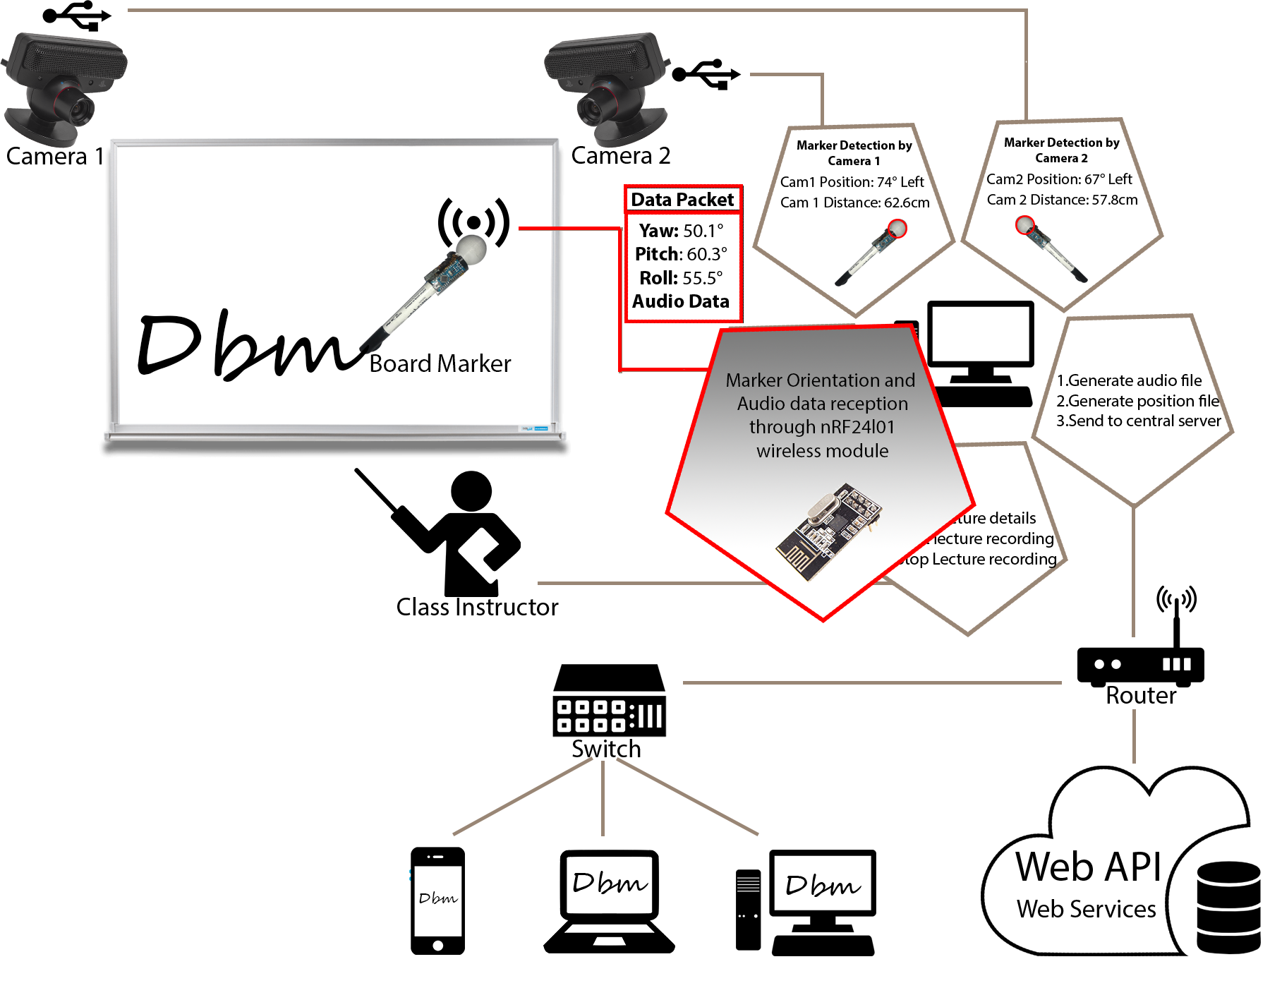
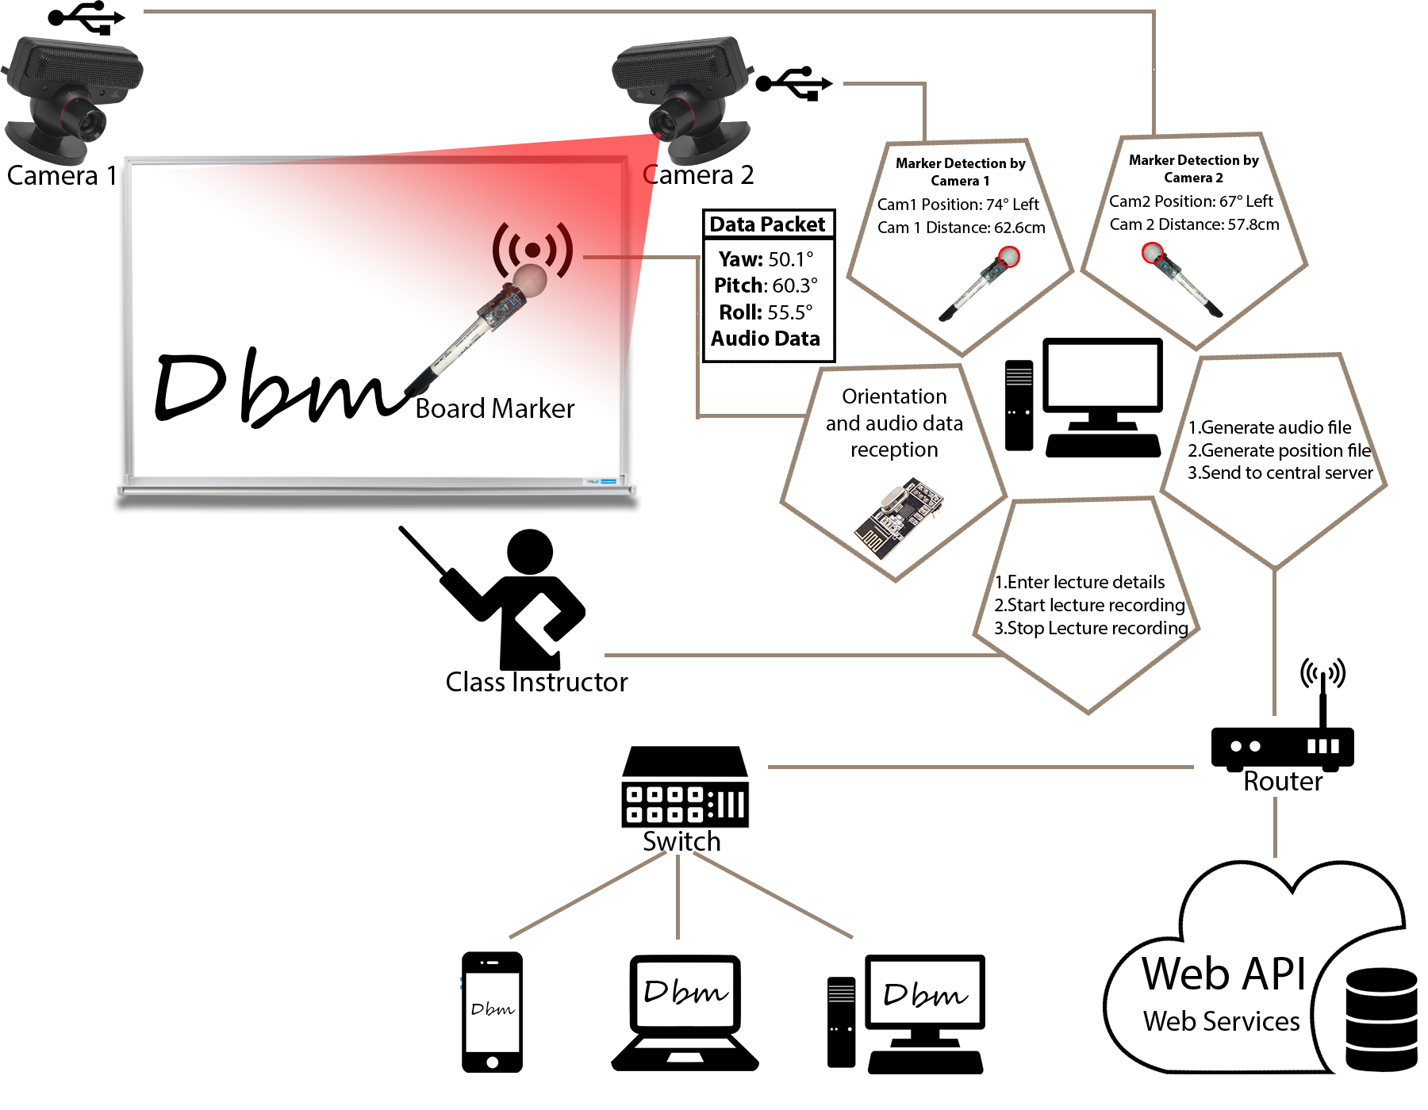
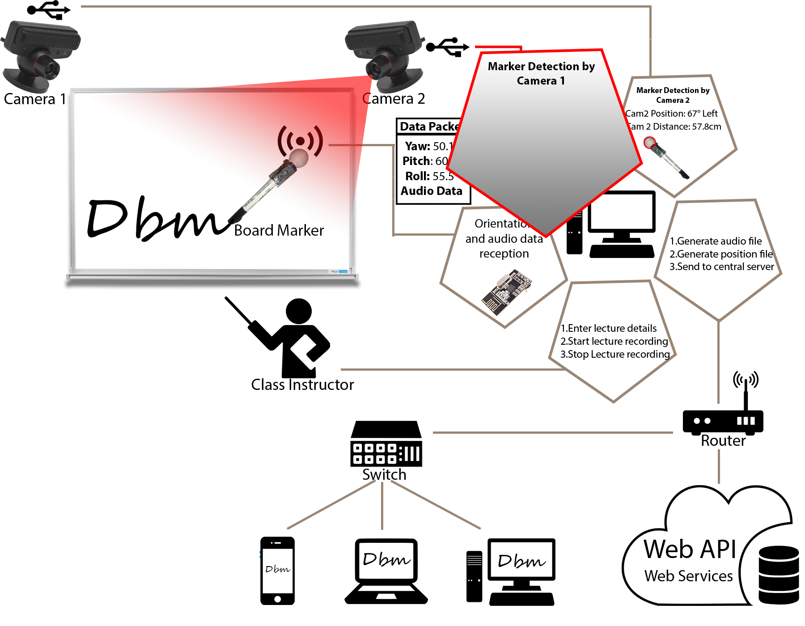

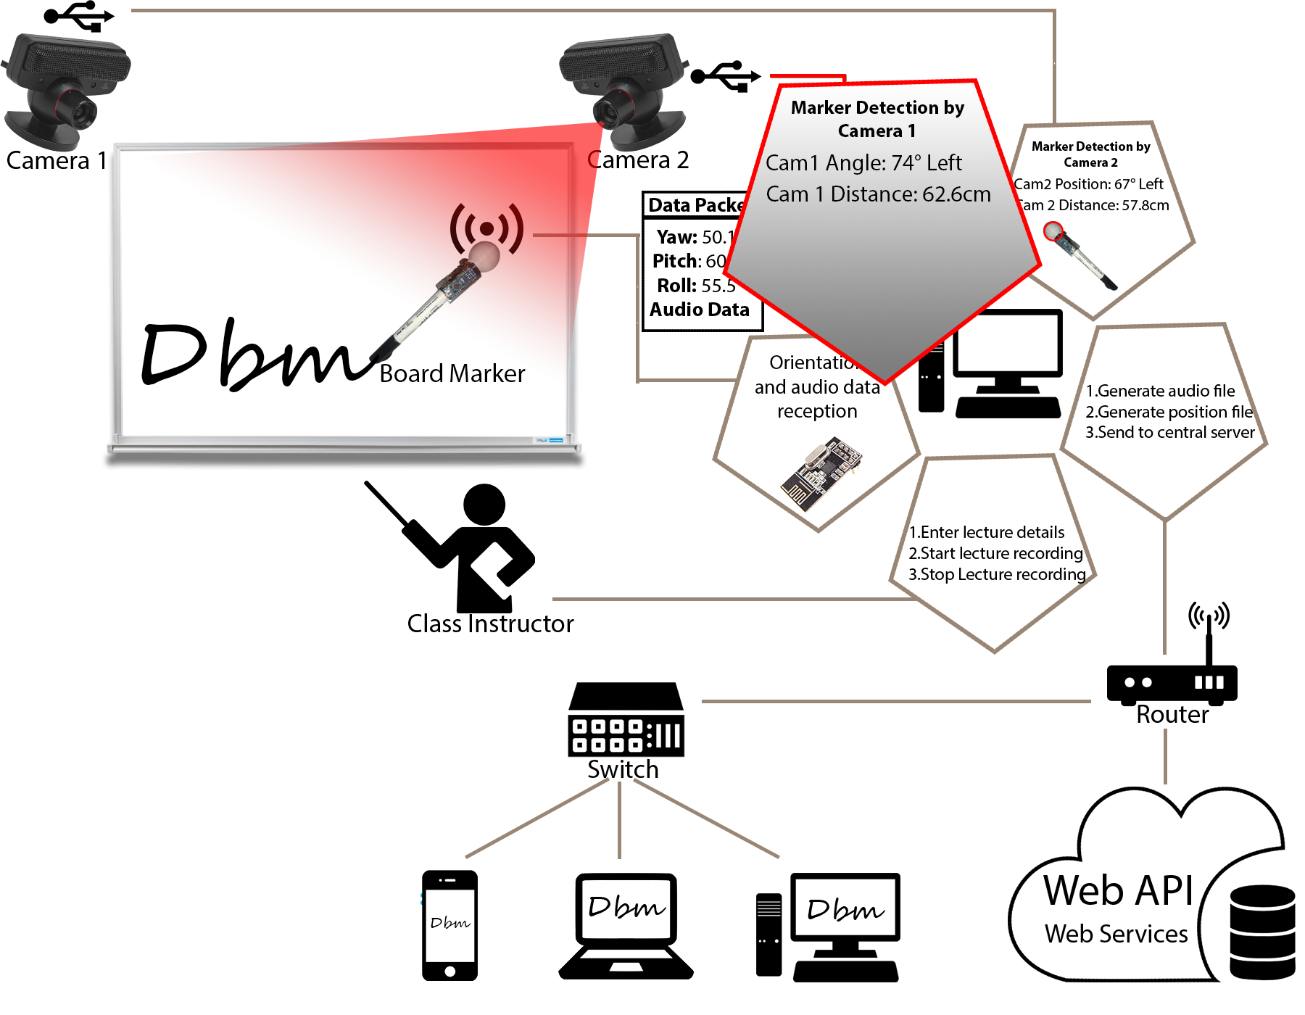

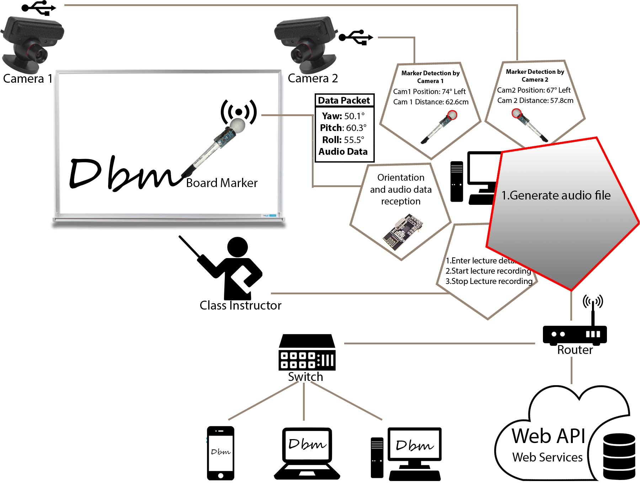
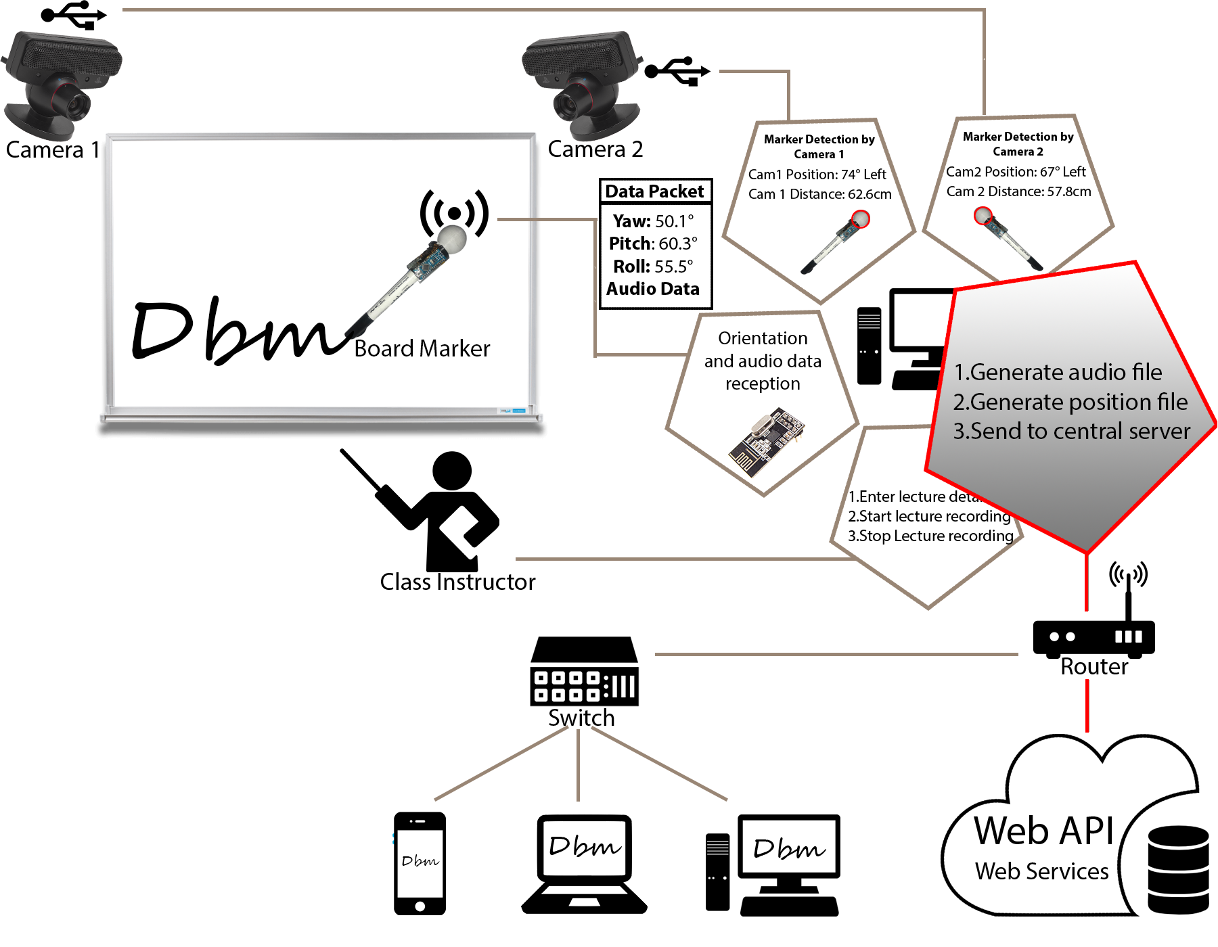
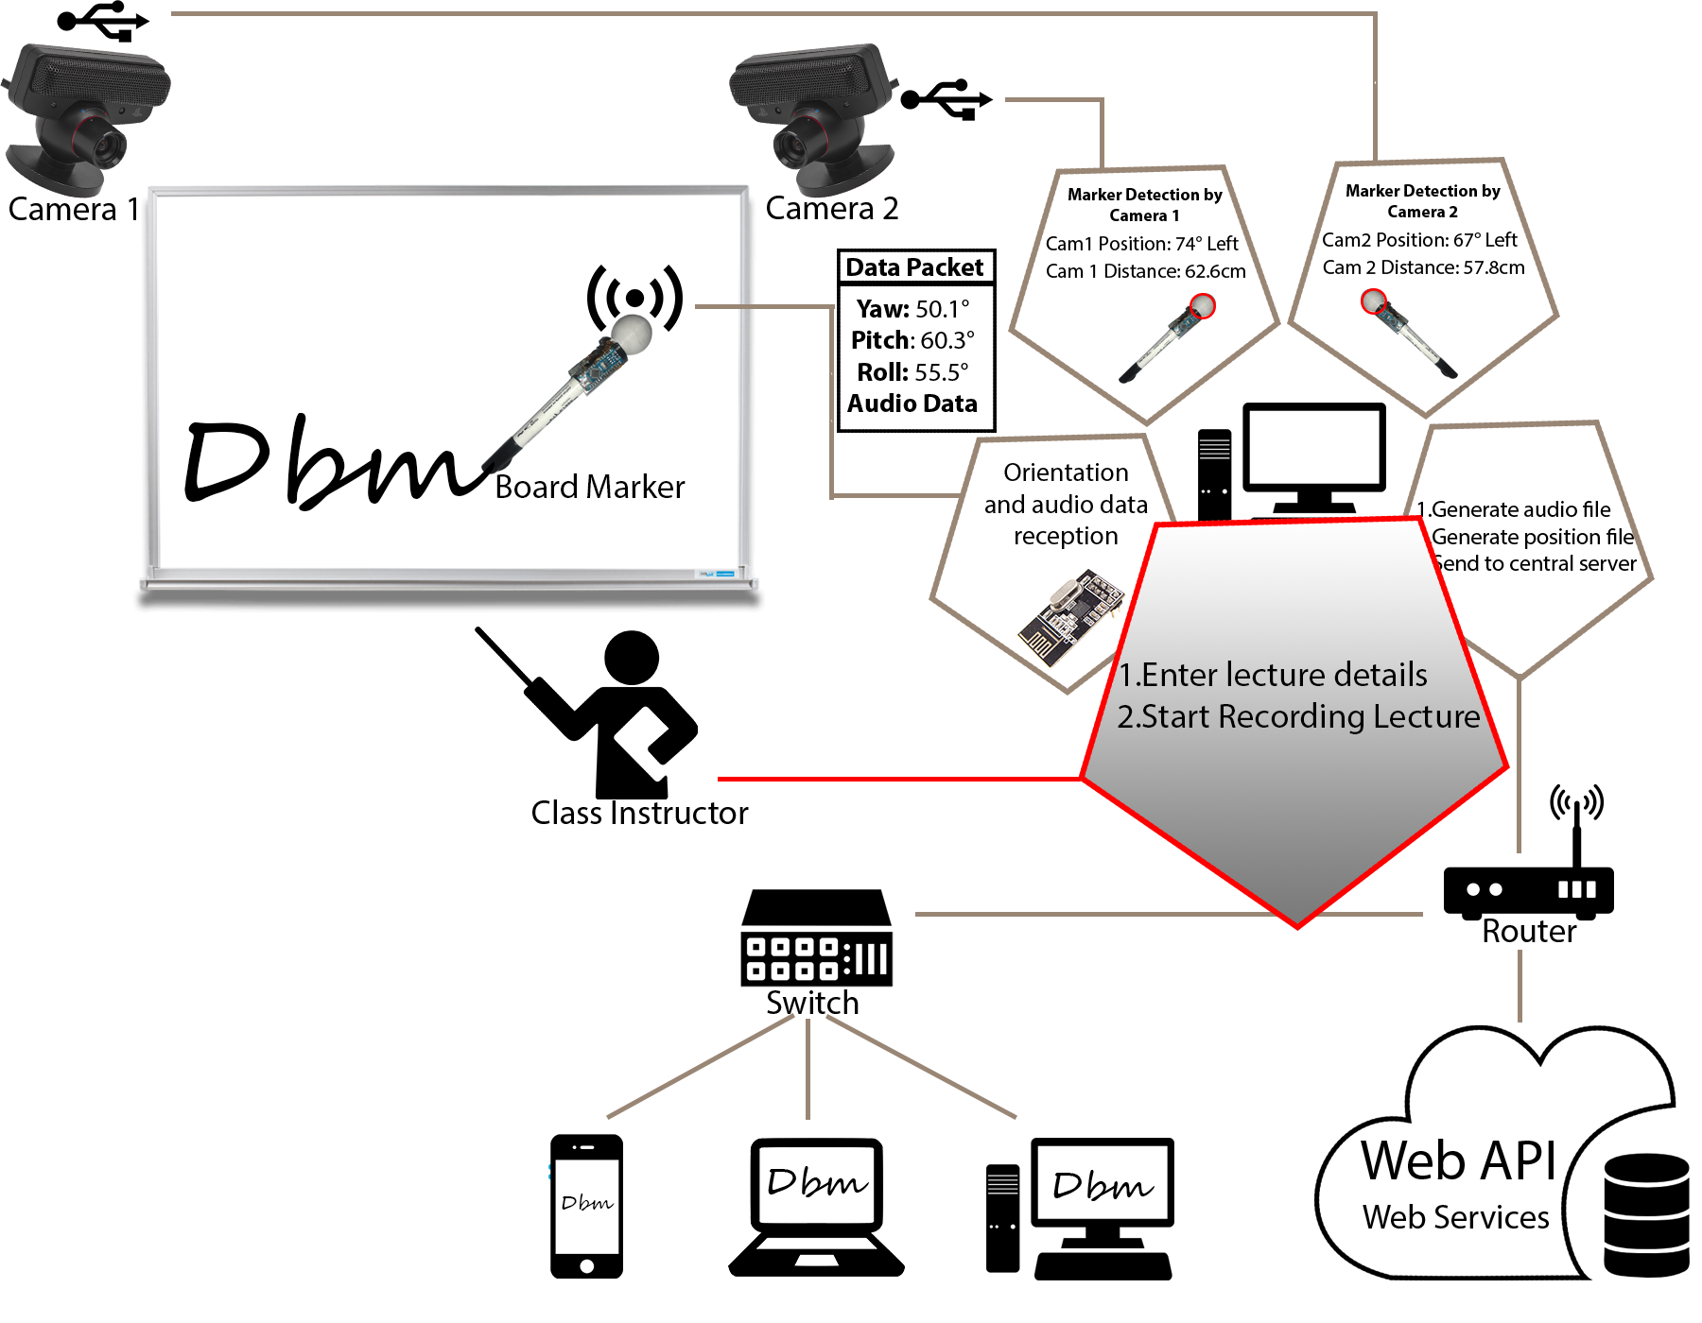
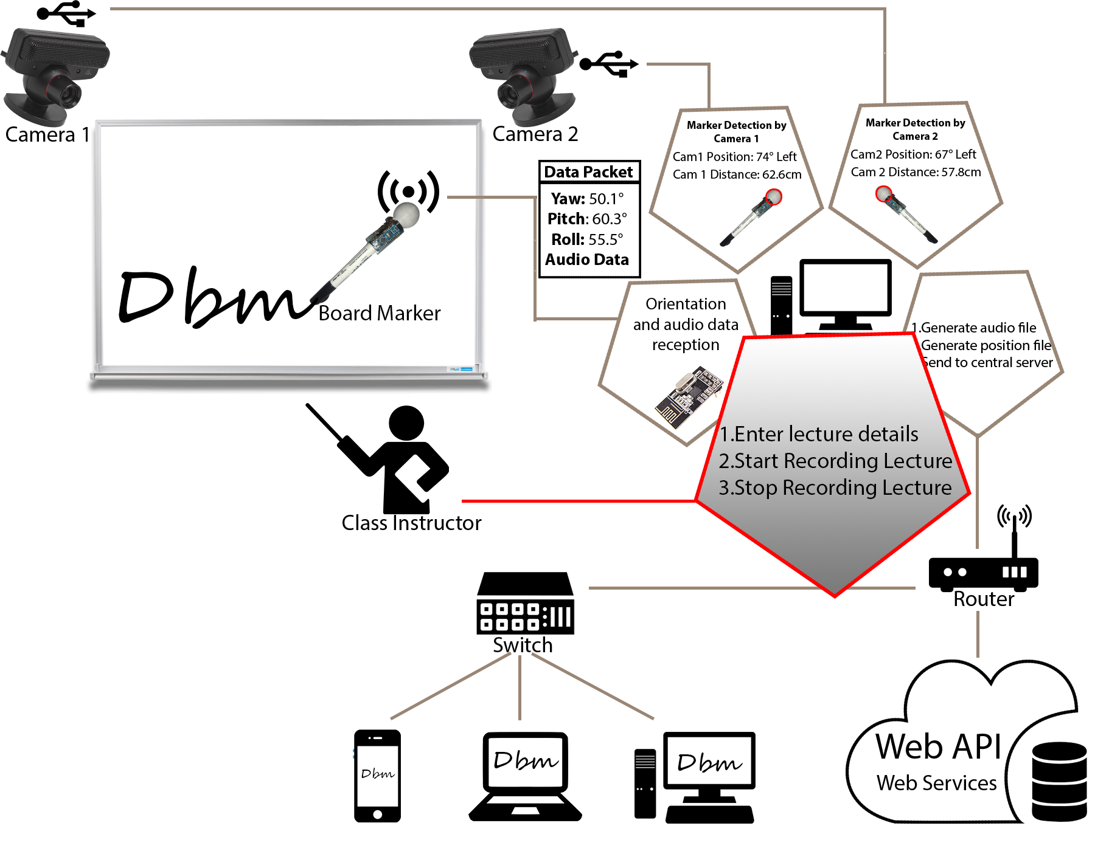
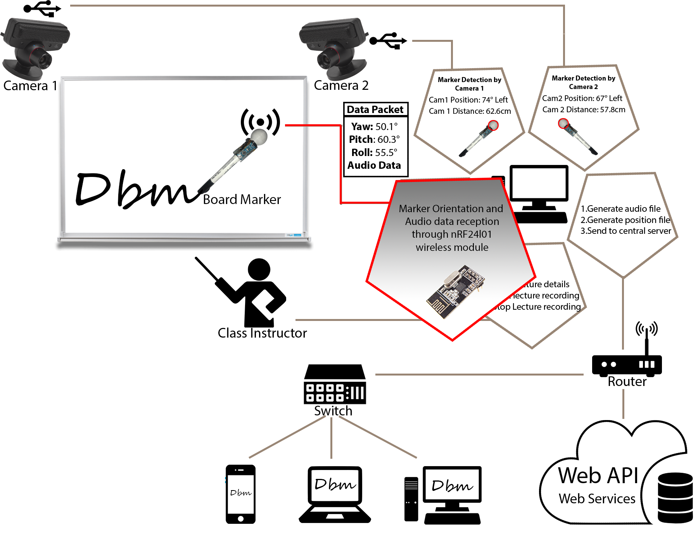
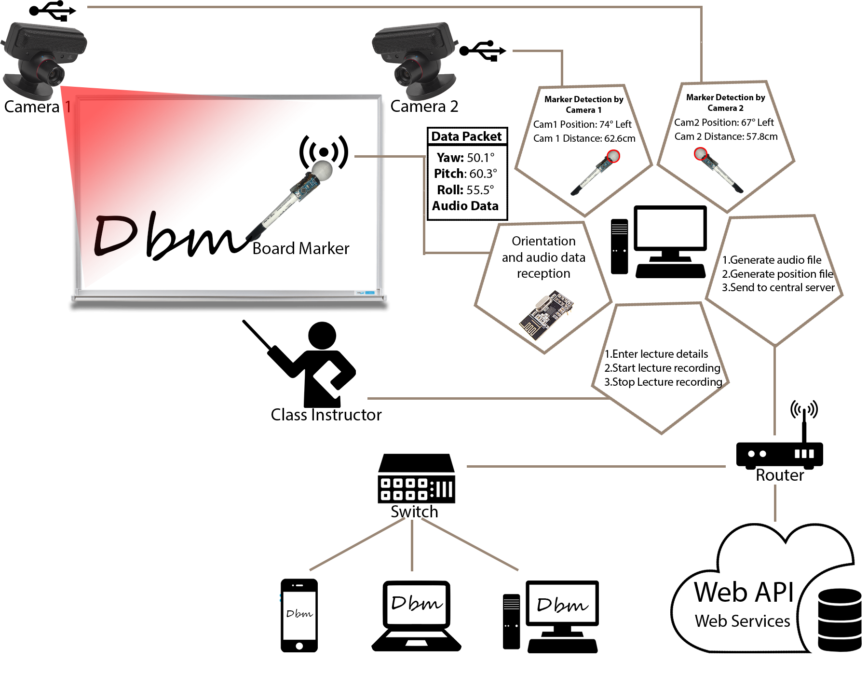

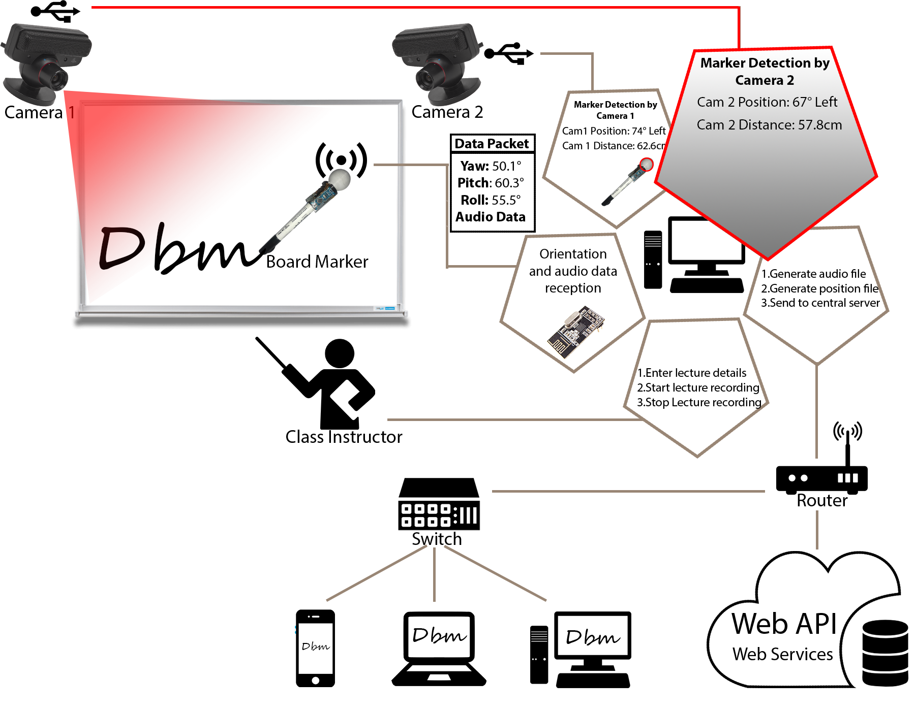
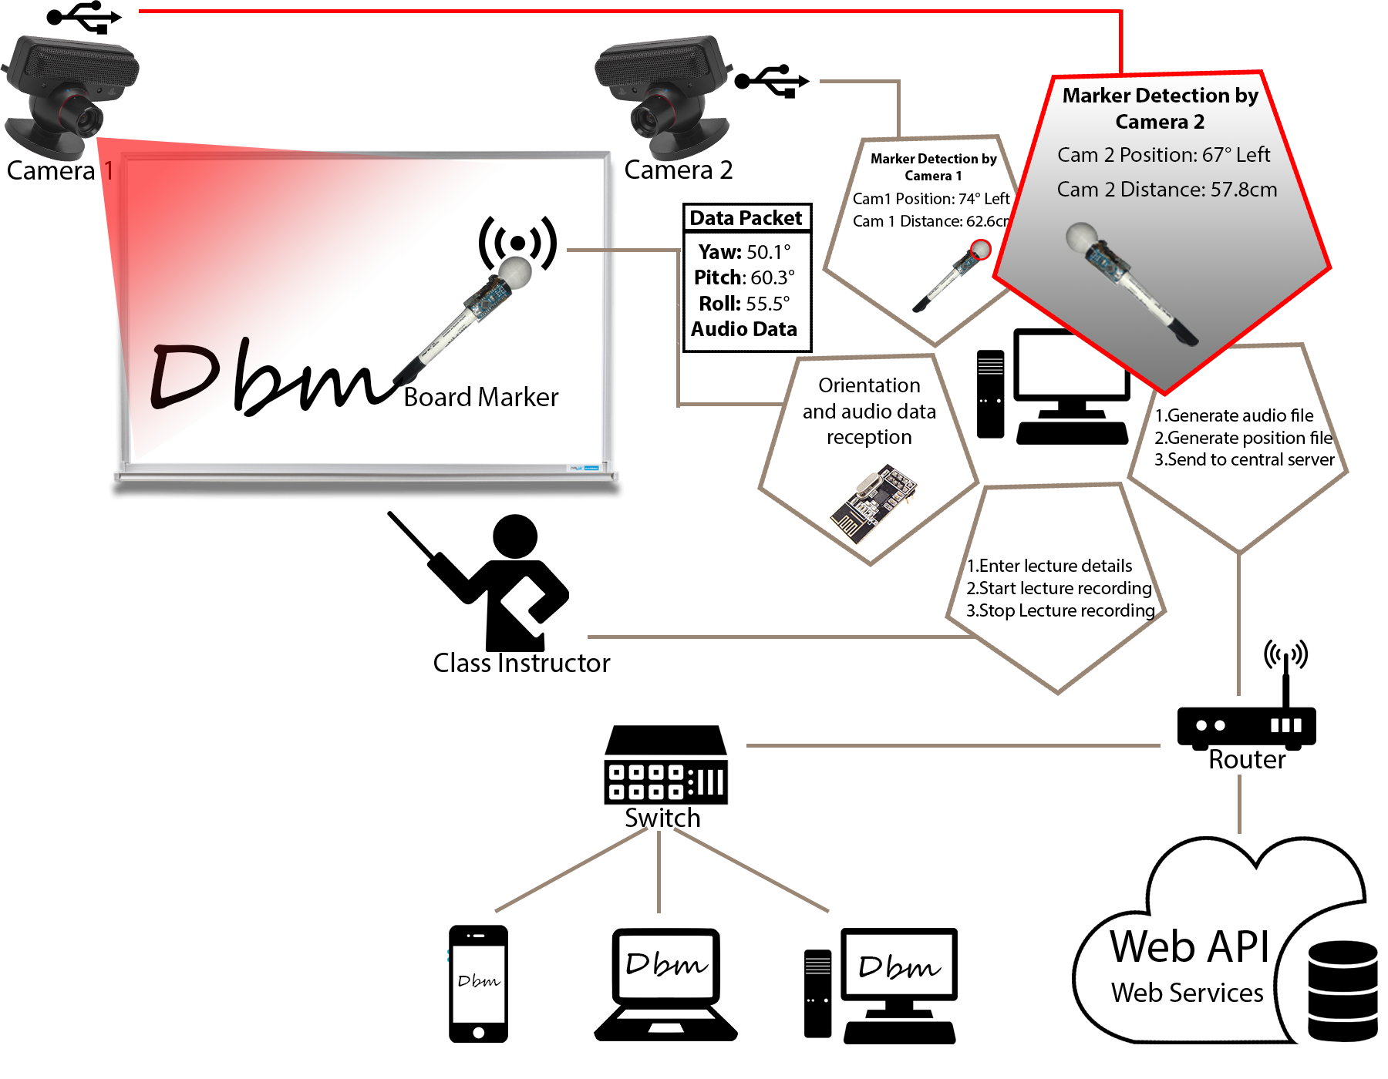

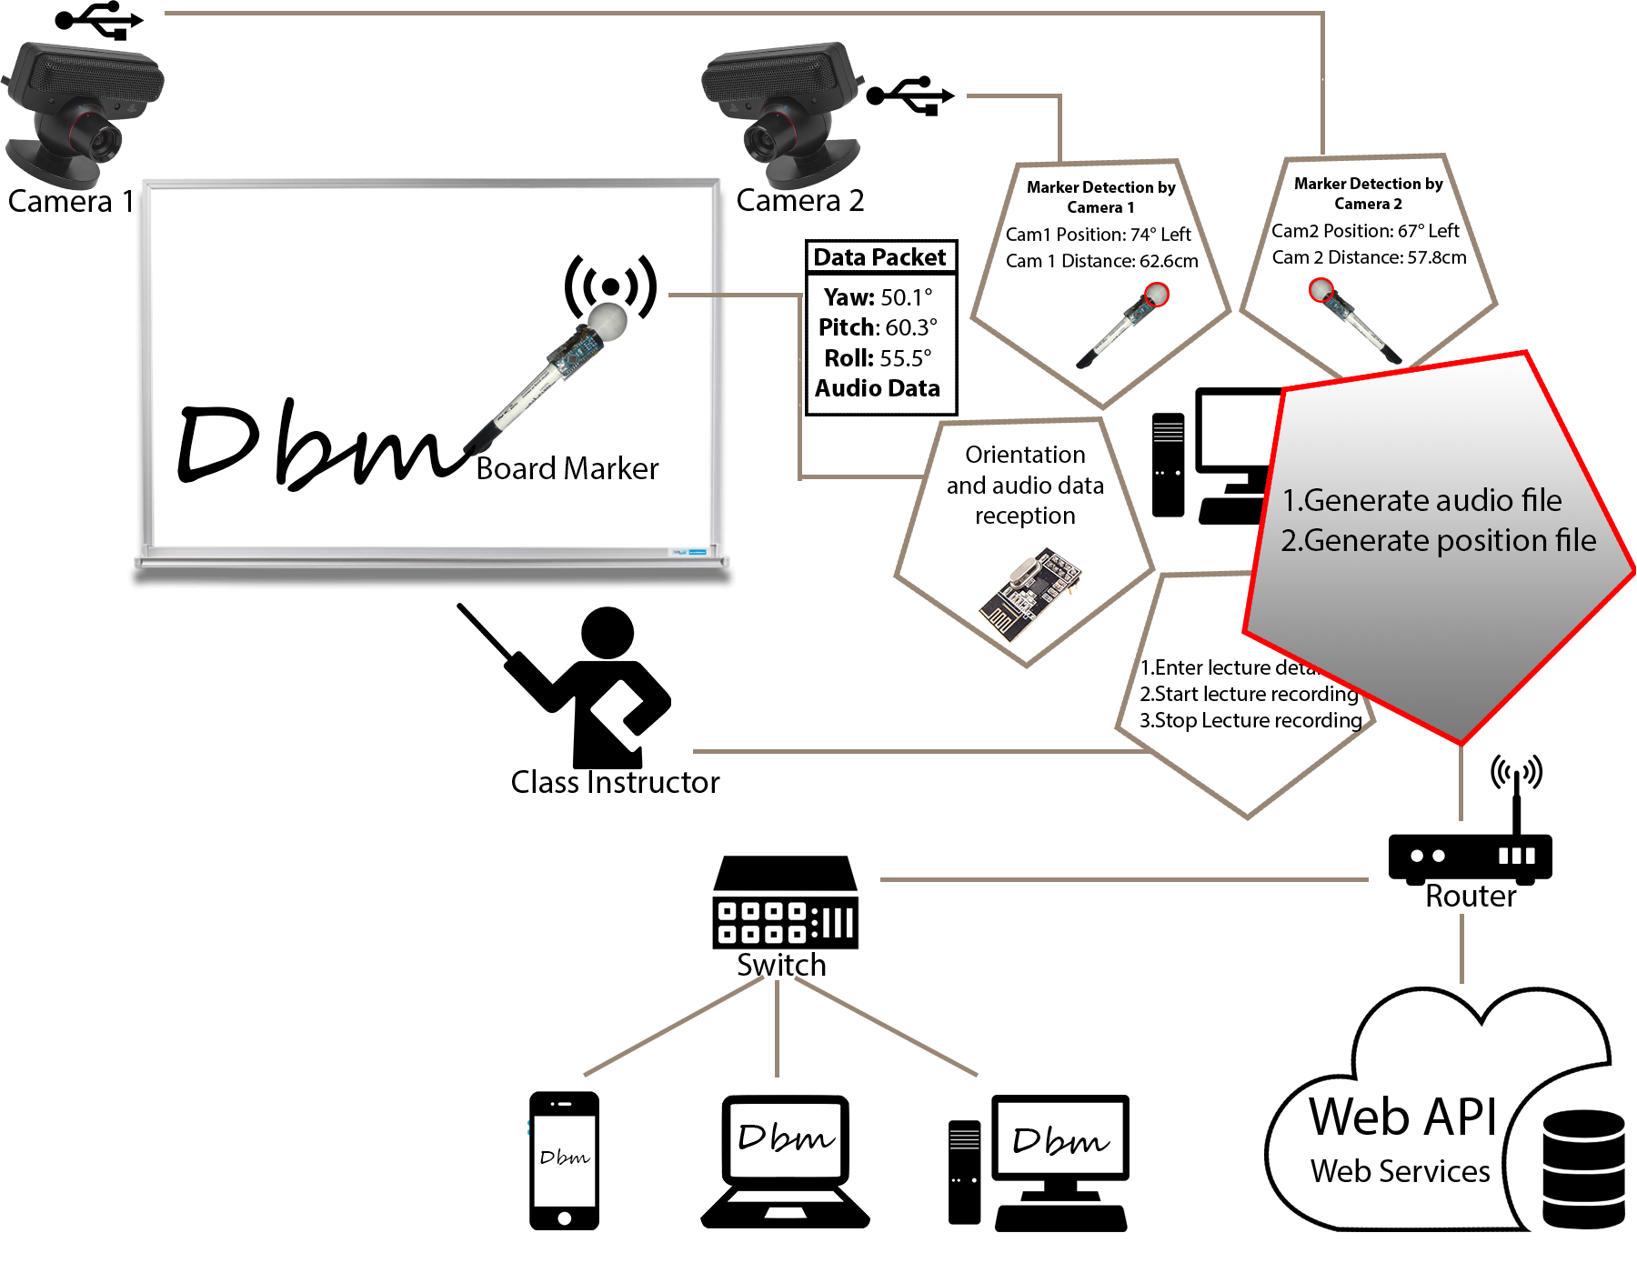
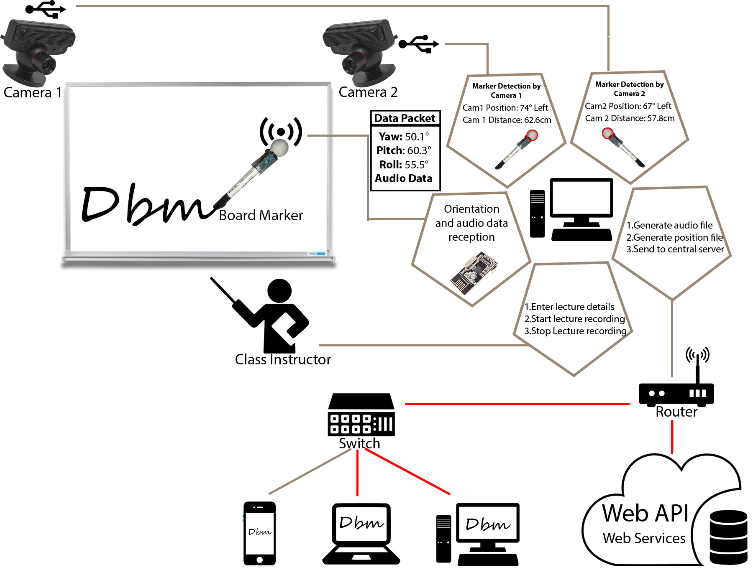
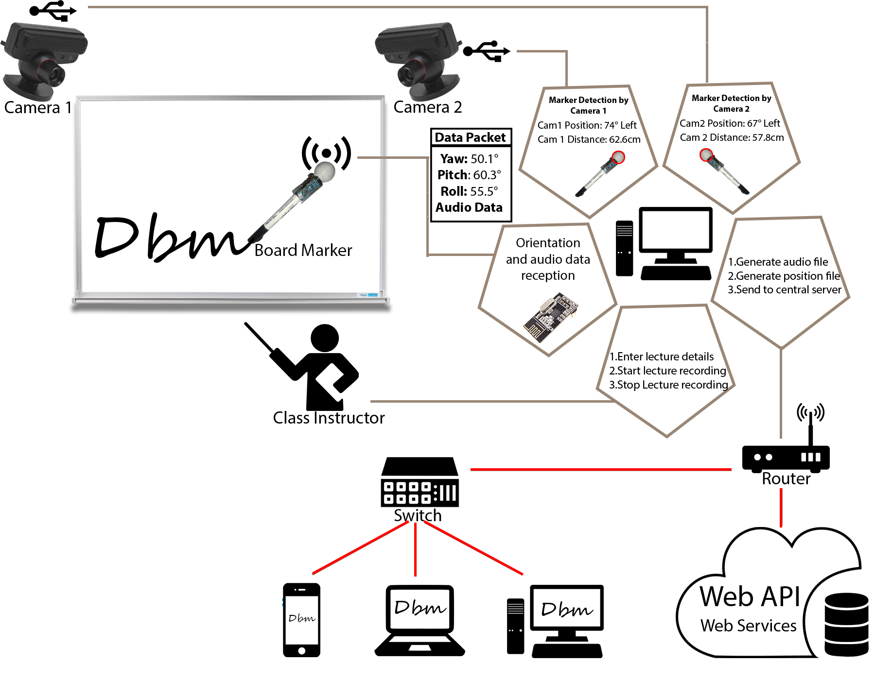


Architecture Diagram

Slide 14
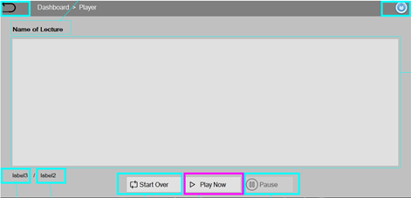
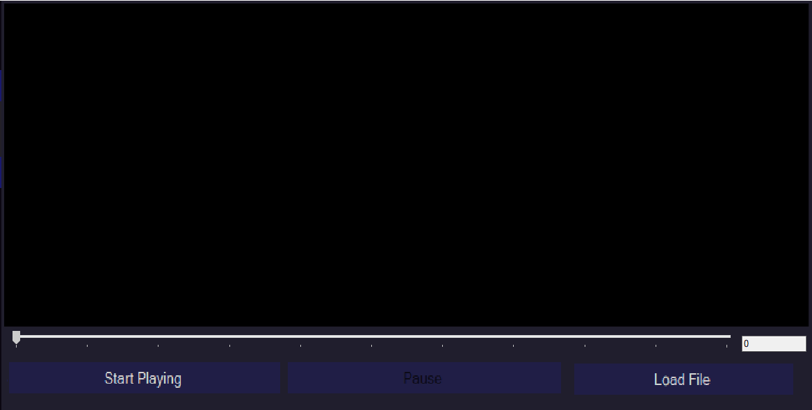
Design Comparison
Player Application
Proposed Design
Implemented Design

Slide 15
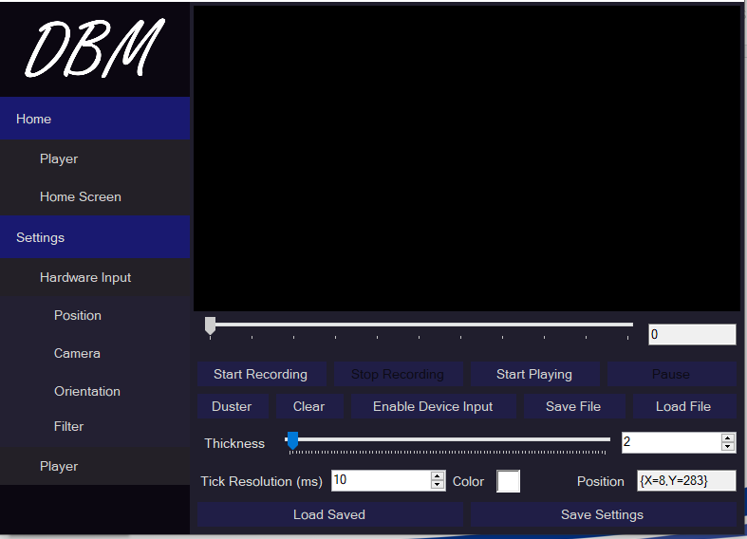
Design Comparison
Controller Application

Slide 16
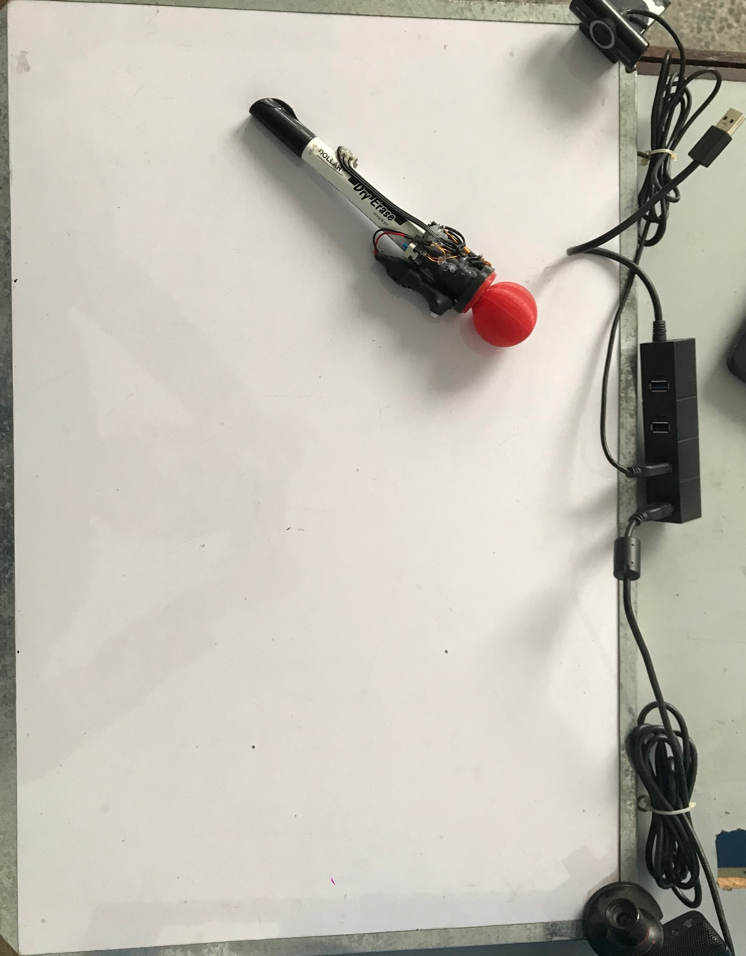
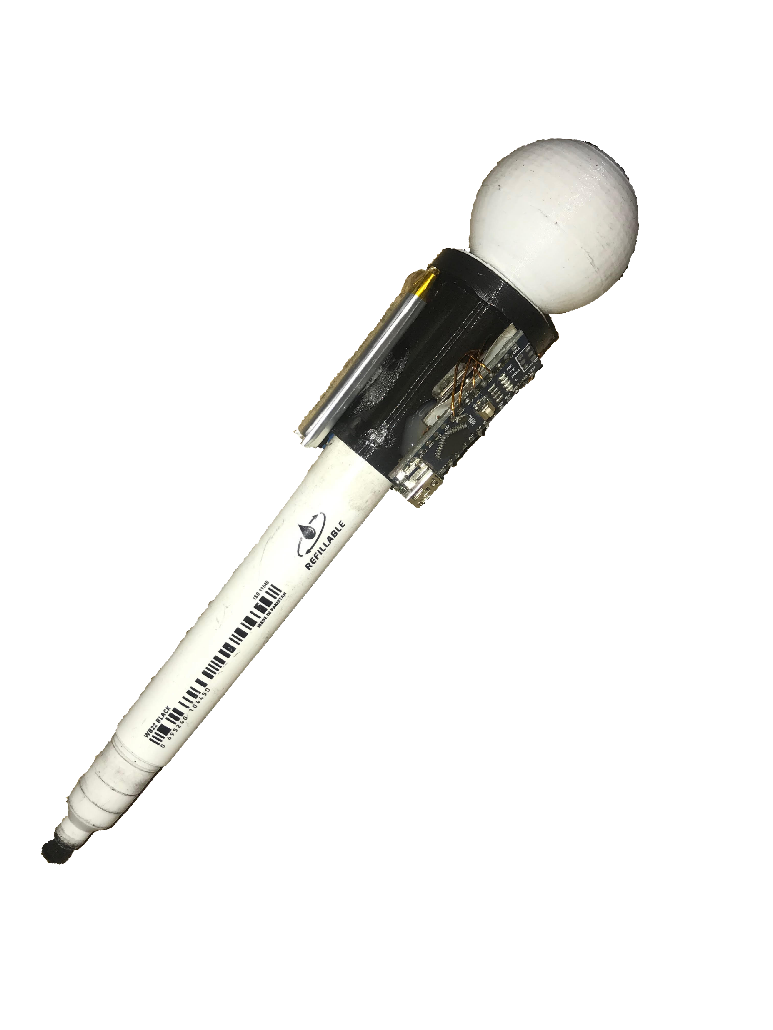
Design Comparison
Hardware(Marker)

Slide 17
Improvements based on feedback
Requirements are clear.
Feasibility study with respect to institutions.
Design and Implementation is clear.
Comparison with respect to storage.

Slide 18



Technologies

Slide 19
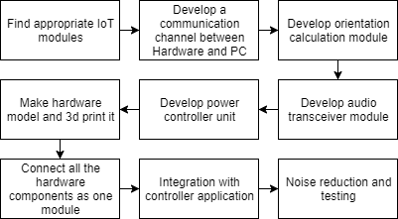
Research Methodology(Hardware)

Slide 20
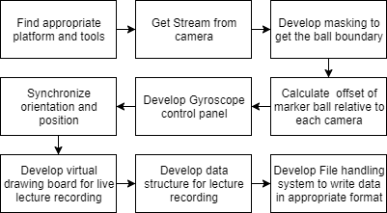
Research Methodology(Controller App)

Slide 21
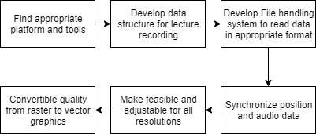
Research Methodology(Player App)

Slide 22
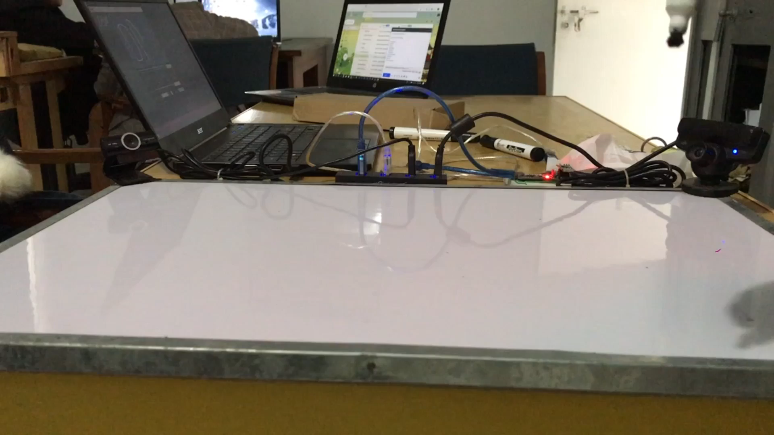
Demo Video(Board Marker)

Slide 23
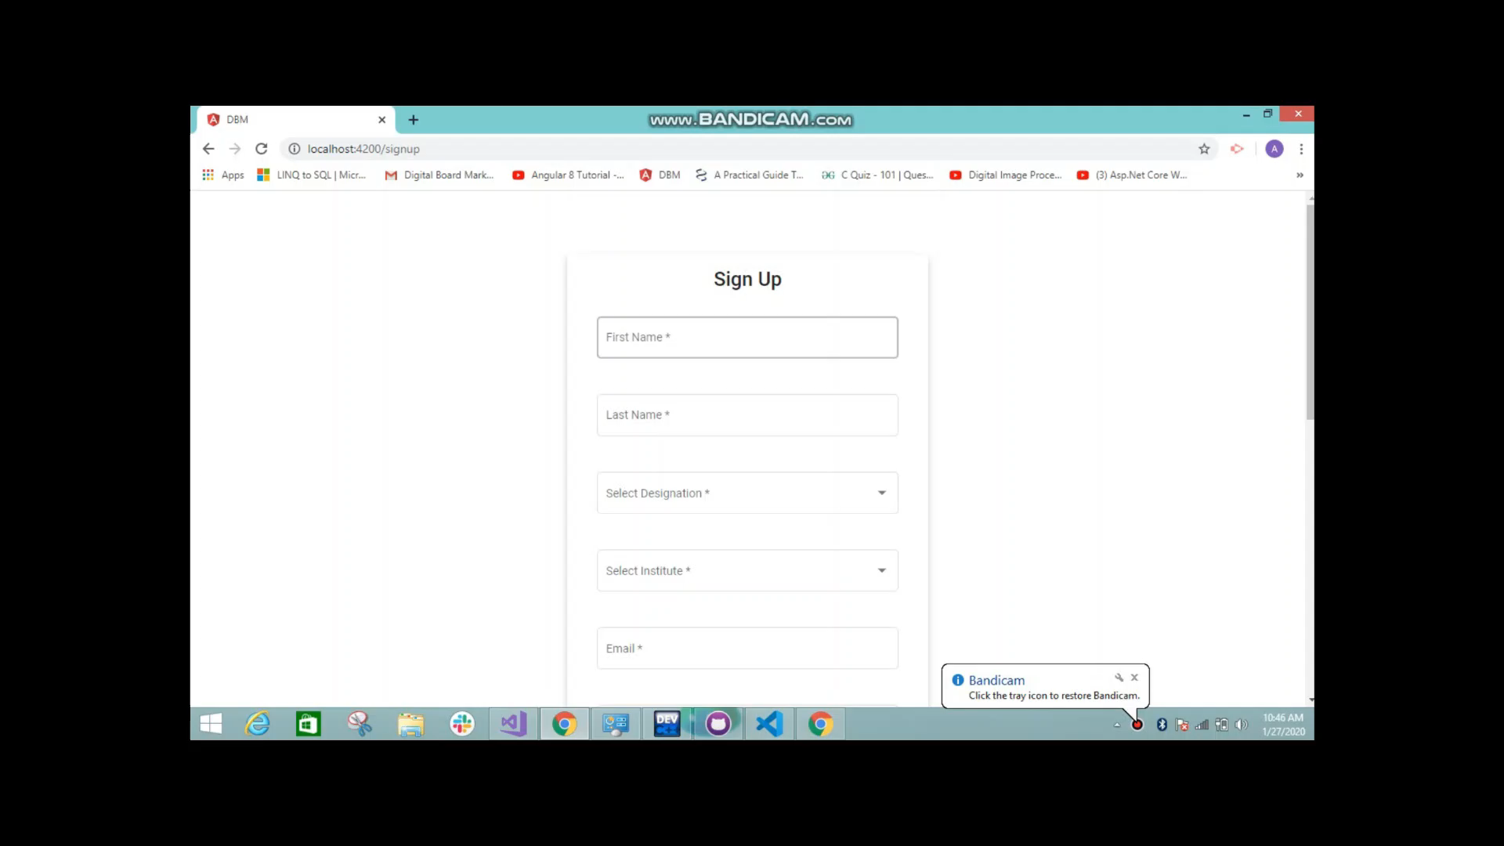
Demo Video( Board marker )

Slide 24

Thank You!

Slide 25

Any Question?

